Slide 1

HyperScript Surge: Bridging Students & Startups
OI-10 Team: HyperScript Surge, Vidyalankar Polytechnic.
Team Leader: Arjun Singh. Members: Daksh Patel, Priya Tiwari, Vaishnavi Javir

Slide 2

Solution Overview
1
Student Projects
2
Startup Talent
3
Web Application
Relevant, engaging project ideas for final year students.
Talented students help solve real-world problems.
Startups post problem statements; students propose solutions.

Slide 3




Technology Stack
Frontend
Backend
Database
EJS, Bootstrap
Node.js, Express.js
MongoDB

Slide 4







Product Flow
User Registration
Login
Problem Statement Portal
Proposal Submission
Project Management Dashboard
Project Completion
Feedback and Ratings

Slide 5

Key Features
Simplified Collaboration
Bridges gap between startups and students.
Problem Statements
Startups post real-world problems.
Proposal Submission
Students submit tailored proposals.
Non-Monetary Rewards
Certificates, LORs, portfolio building.

Slide 6
USPs
Bridging the Gap
Non-Monetary
Streamlined Submission
Connects startups and students for mutual benefit.
Unique, non-financial relationship.
Mimics real-world software development.

Slide 7
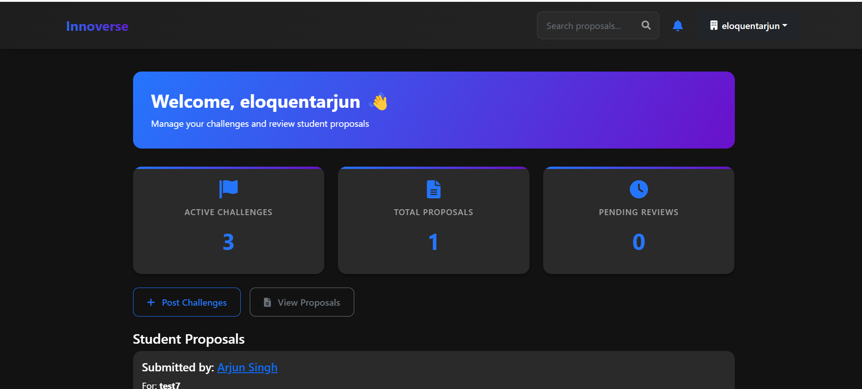
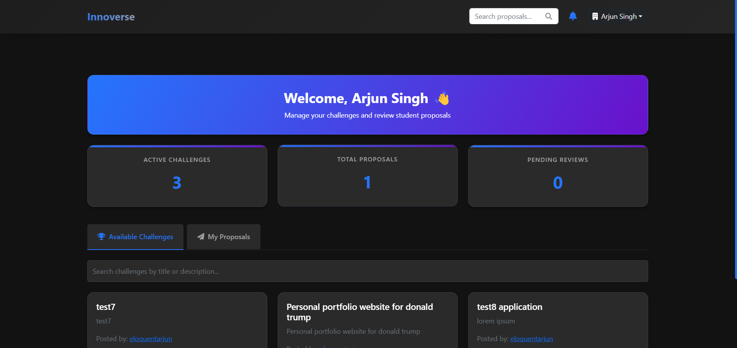

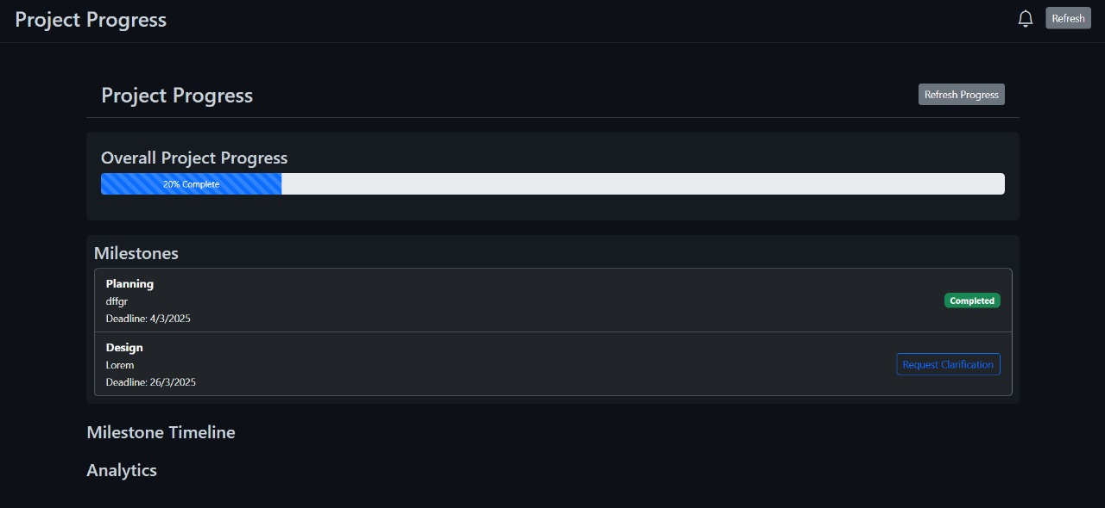
DEMO

Slide 8

Future Scope
1
Collaboration Tools
Chat, video conferencing, shared workspaces.
2
Project Showcasing
Students showcase completed projects.
3
Gamification
Leaderboards, challenges, rewards.

